Slide 1
Sensorem:
Arduino-based MIDI controller for Ableton Live and Max MSP
EP - 353: Audio Programming in C
Mateo Larrea Ferro
Fall2020

Slide 2
Project Description
Sensorem is a piece of technology with two main functions:
Allow the user to compose melodies based on his/her distance to an ultrasonic sensor.
Process and transform the melodic input by mapping effects and MIDI parameters to the controller.
It is a performance and composition musical tool
Instrument and Controller

Slide 3
Why Sensorem?
A tool that will allow musicians like myself to create based on a different/new set of limitations.
Opportunity to combine knowledge on circuits, physical computing, Max, C, Ableton, and music production.
Philosophy: Create tools that might change the output of our work.
Inspiration: Akito’s MM-RT and Max Matthew’s Radio Baton

Slide 4
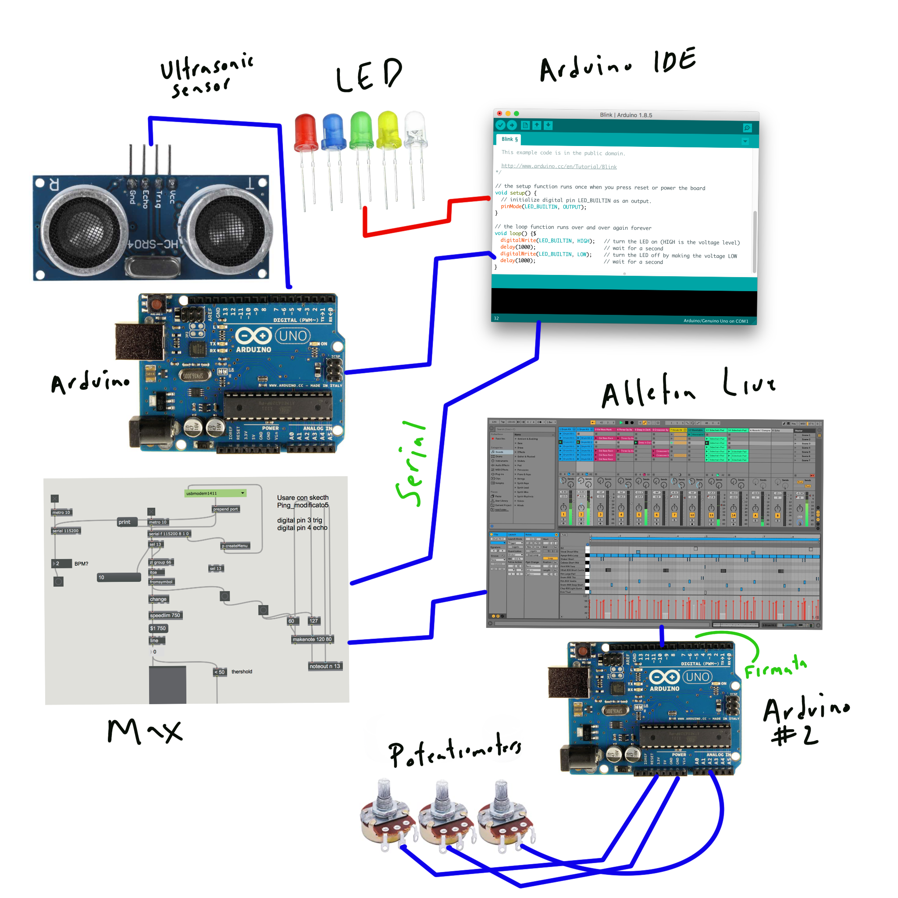

Slide 5
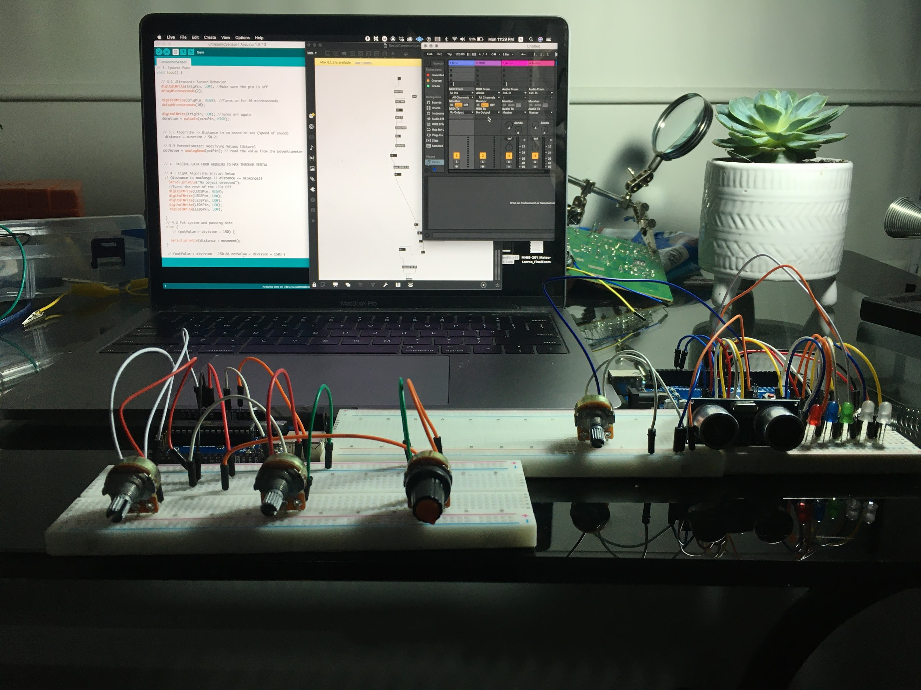
How it works: Overall System

Slide 6
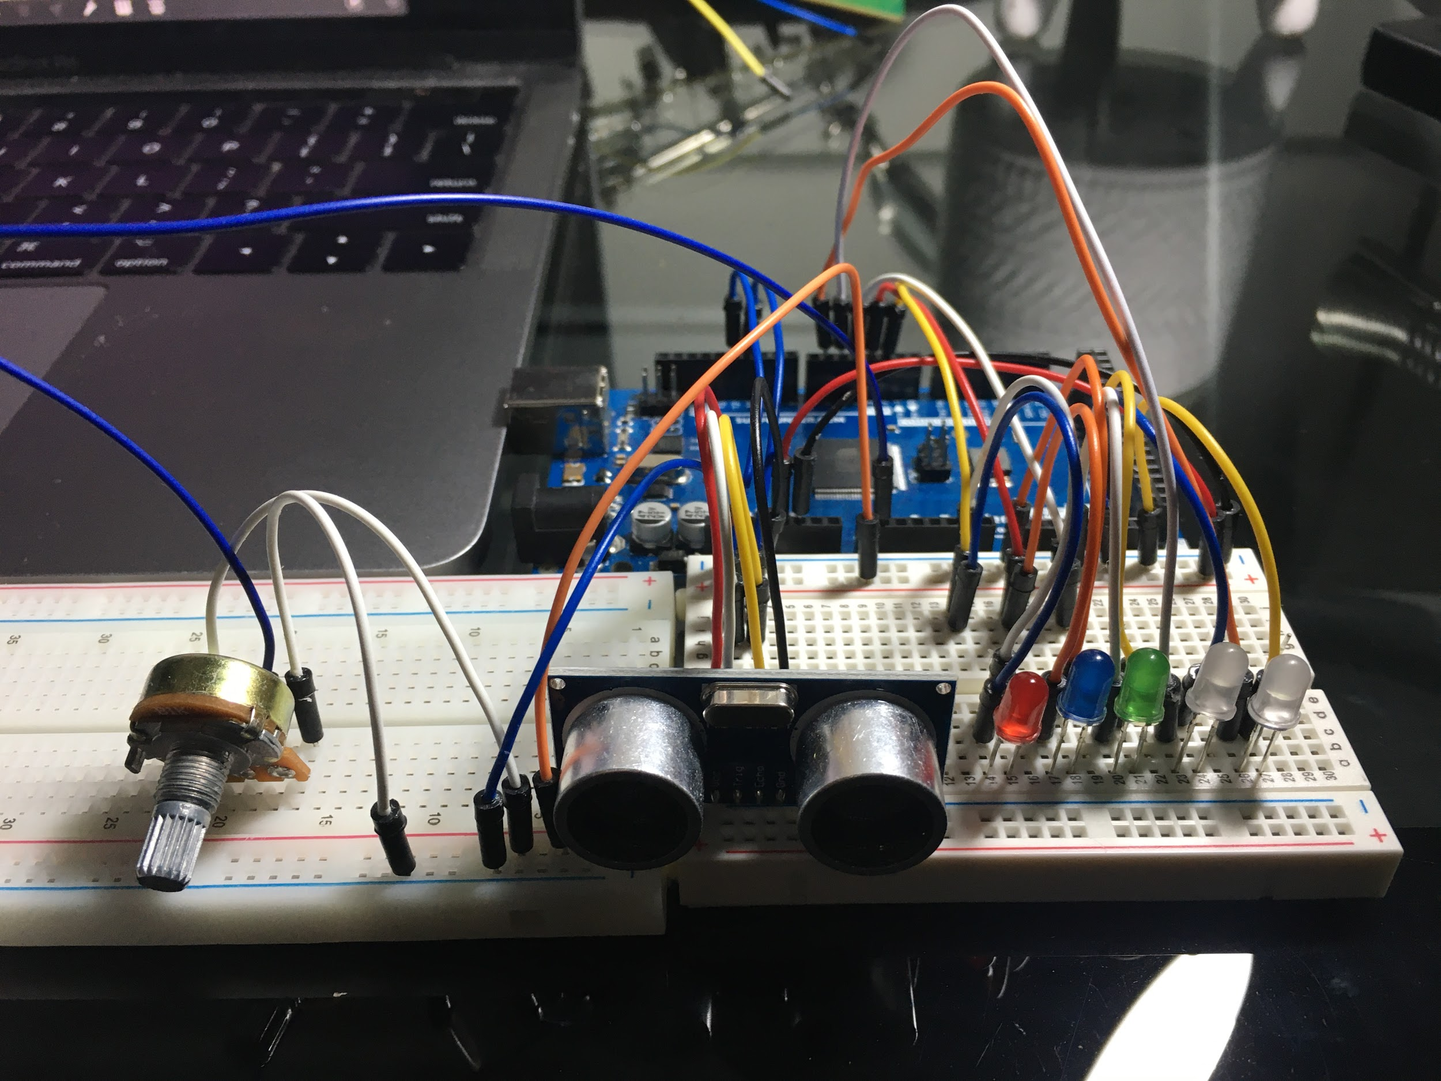
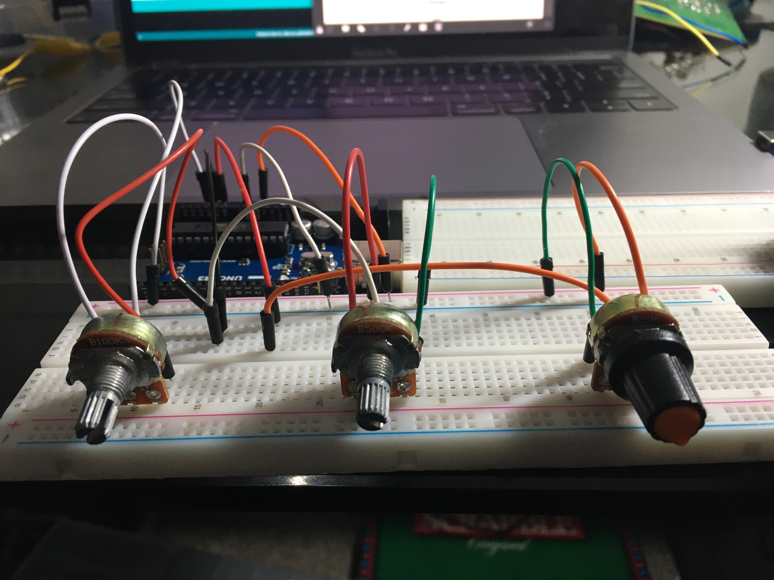
How it works: Physical Form

Slide 7
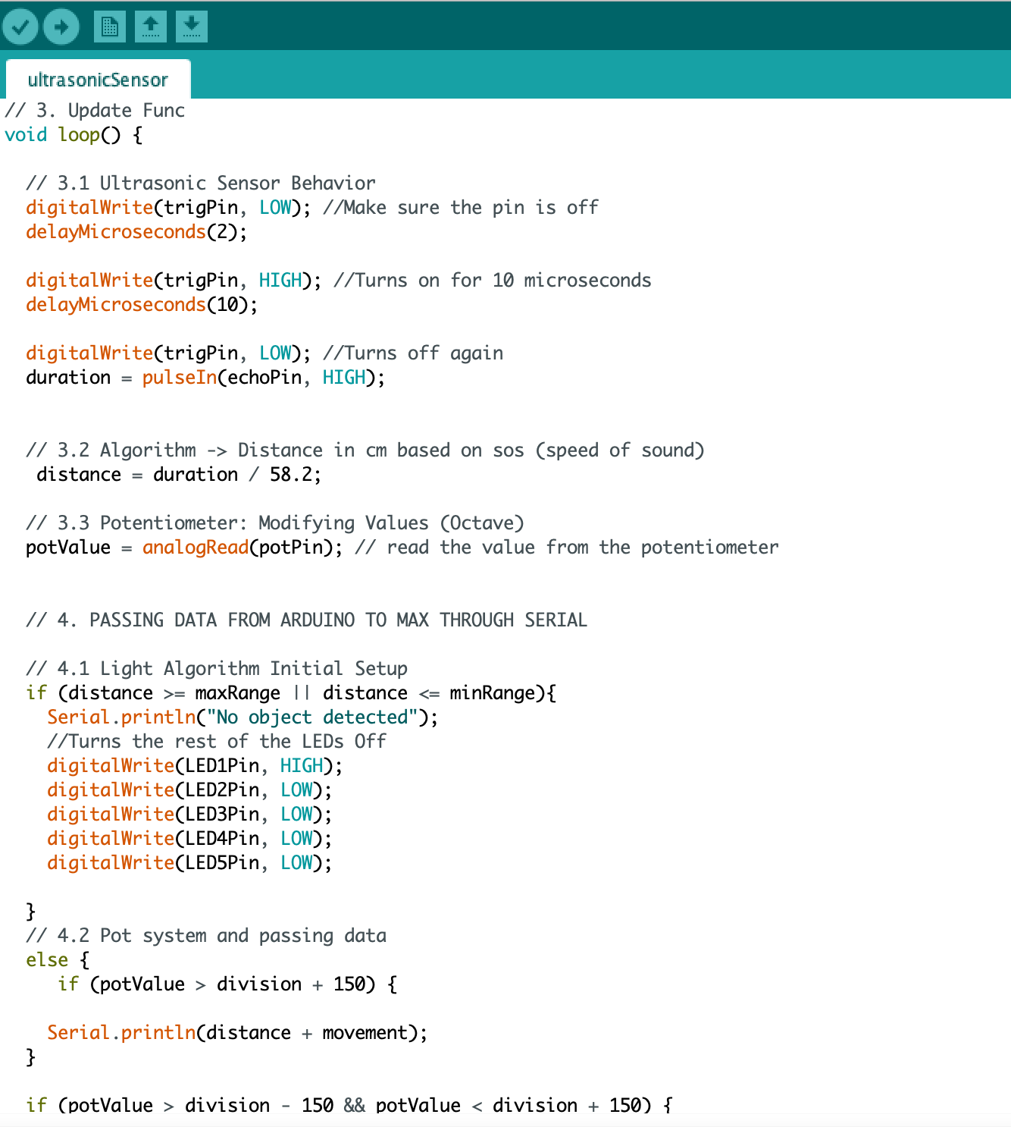
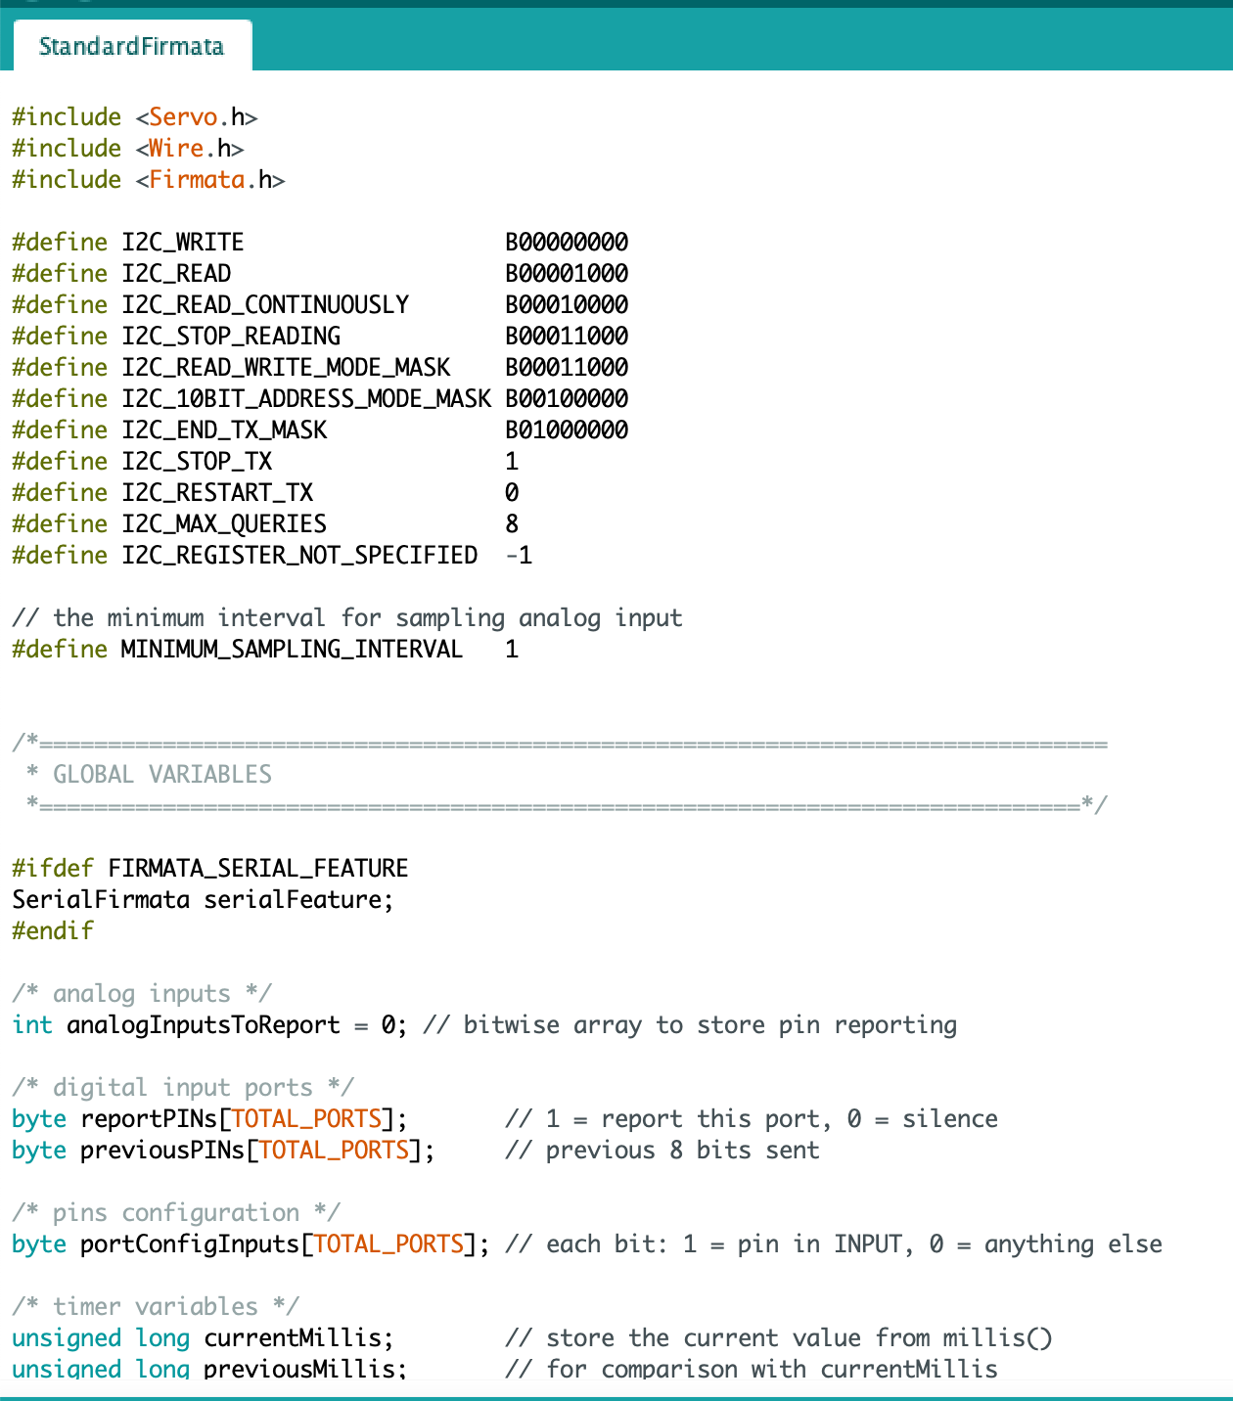
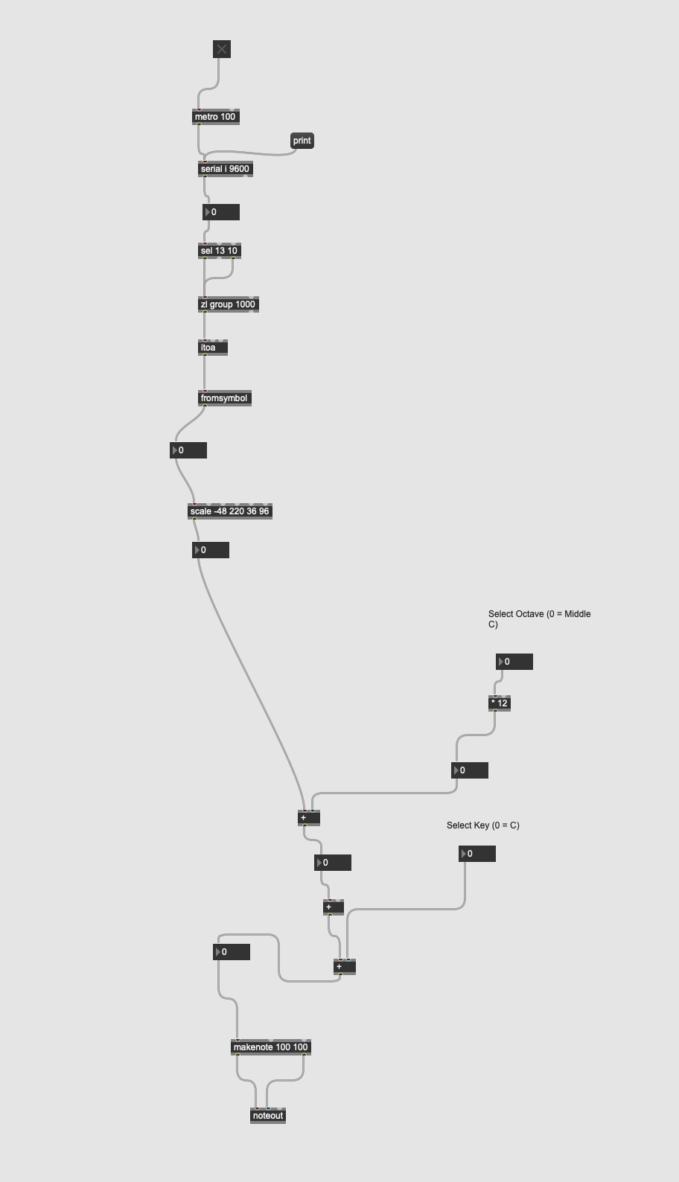
How it works: Software Description

Slide 8
DEMO
https://drive.google.com/drive/folders/11Hi741M6CZgWx-uHbK15BFcKGjlInpMz?usp=sharing

Slide 9
What Works: Advantages
Instrument and Controller (Ultrasonic Sensor + Firmata)
LED system
Octave Shifter (Range)
Max and Ableton connection

Slide 10
Improvements: What does not work yet
Fusion between scripts (Firmata + MIDI input)
LDRs and Piezo
Single box with ergonomic qualities

Slide 11
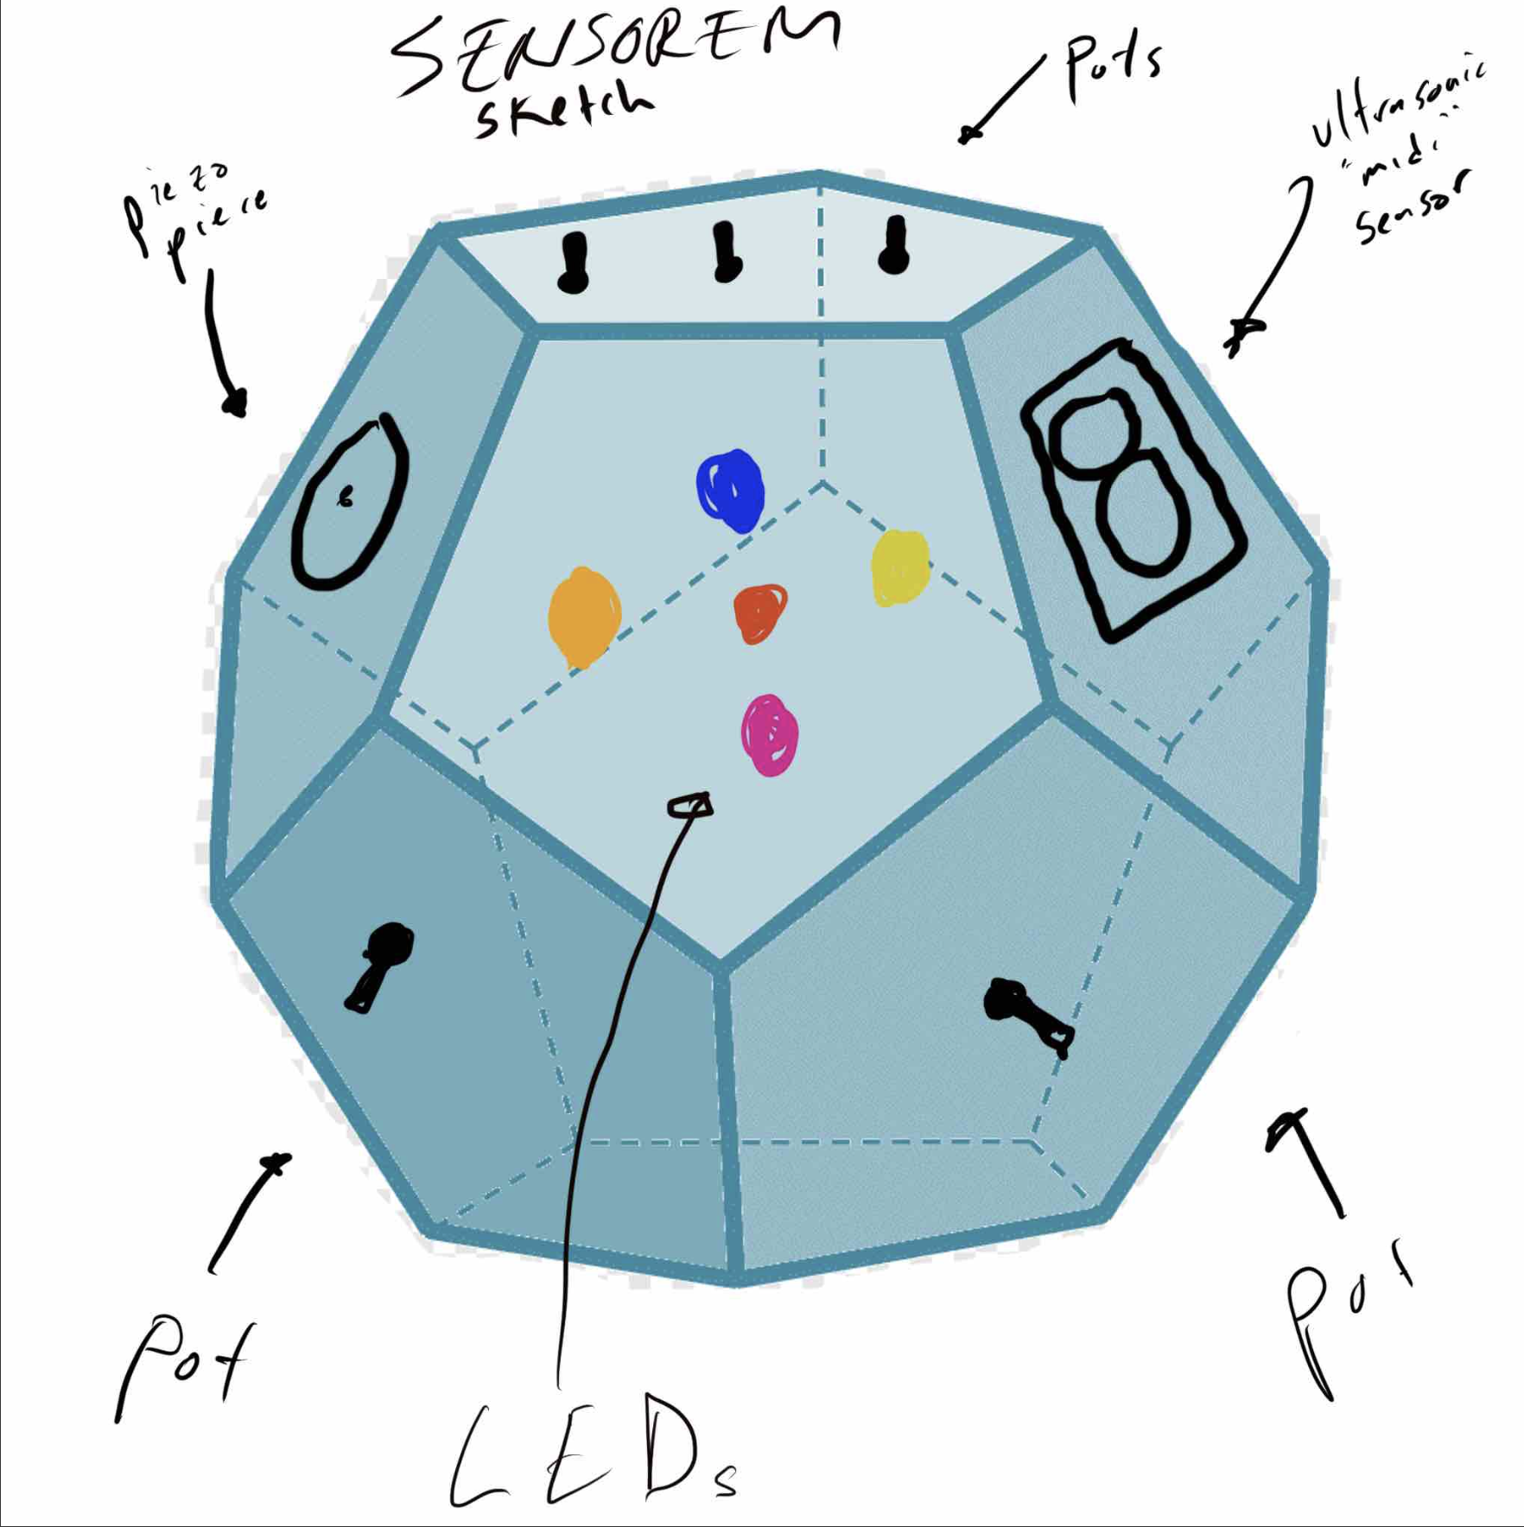
Future Implementation
Box
Harmony Trigger
Different melodic modes
Heart-rate sensor to establish tempo

